Slide 1
Prediction of factors affecting Amlodipine Induced Pedal Edema and its classification
Aman Chopra
Ashray Dimri
Tribikram Pradhan

Slide 2
Outline
Problem statement/ Motivation
Related Work
Dataset
Methodology
Results
Summary
Future Work
References

Slide 3
Problem Statement Prediction of Factors affecting Amlodipine Induced Pedal Edema and its Classification
Pedal Edema

Slide 4
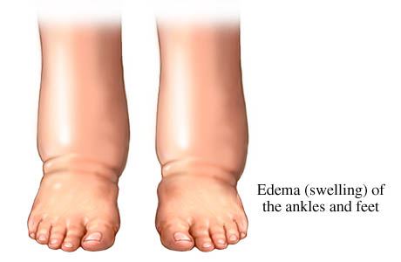
Swollen foot in pedal edema

Slide 5
Problem Statement Prediction of Factors affecting Amlodipine Induced Pedal Edema and its Classification
Pedal Edema
Amlodipine

Slide 6
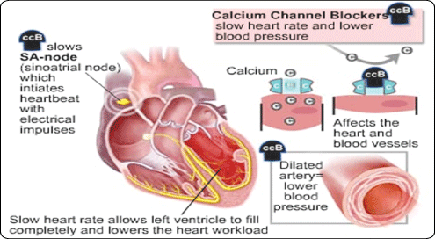
CCB working on heart and arteries

Slide 7
Problem Statement Prediction of Factors affecting Amlodipine Induced Pedal Edema and its Classification
Pedal Edema
Amlodipine
Why?

Slide 8
Related work
Prescription-event monitoring.
Comparitive study with other CCBs.

Slide 9
Dataset.
Dataset
206 patients
38 attributes

Slide 10
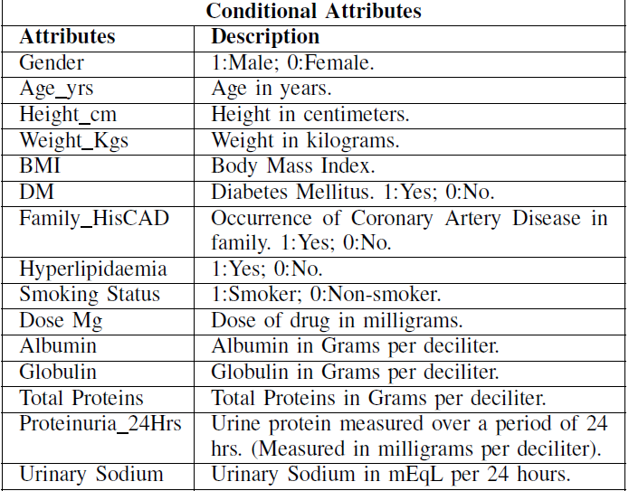
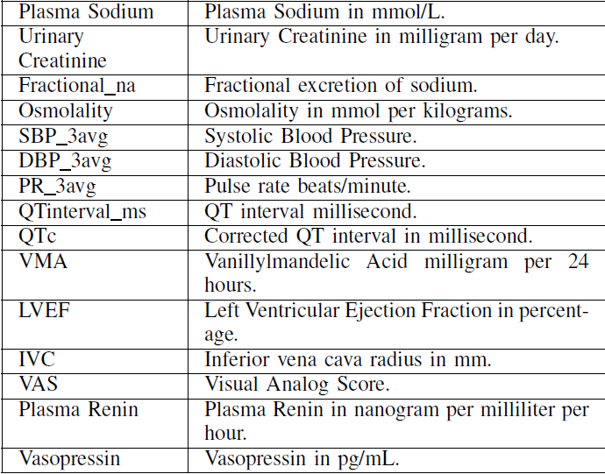

Slide 11
Dataset
Dataset
206 patients
38 attributes
3 groups/classes
Amlodipine treated without side effects.
Amlodipine treated with side effects.
Amlodipine side effects and then shifted to clinidipine.

Slide 12
Proposed Method
Feature Selection.
Random Forest
As an initial step Random Forests algorithm for feature selection was used, as they try to cope with the small sample size problem by building a large number of models from slightly varying subsets of the data.

Slide 13
Proposed Method
Recursive Feature Elimination
This algorithm is used to build many models with different subsets of a data set and predict those attributes that are not important to build an accurate model.

Slide 14
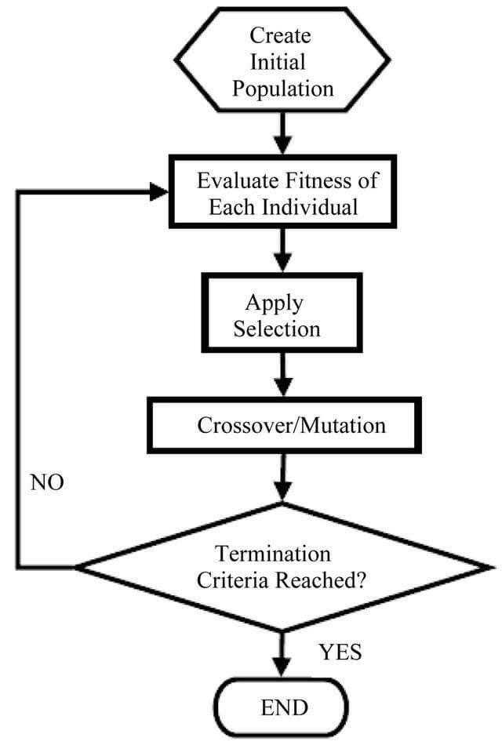
Proposed Method
Genetic Algorithm
This algorithm follows four steps i.e., selection, reproduction, evaluation and replacement. An approximate best solution can be obtained using genetic algorithm as it generates a very high number of possible models.

Slide 15
Proposed Method
Boruta
Boruta finds all features which have an impact to the decision variable. This makes it very useful for biomedical applications. It takes into account all the important attributes which are in some way related to the predictable attribute.

Slide 16
Proposed Method
Classification
Support Vector Machine
SVM was used to keep the model simple so it won’t over fit. On initial analysis it was found that the attributes were not linearly separable so a non-linear radial kernel was used.

Slide 17
Results
Prognostic markers: osmolality, Proteinuria 24Hrs, Albumin, QTc, DBP 3avg, QTinterval ms, Dose.Mg, Vasopressin., Plasma.renin., Fractional Na, IVC, LVEF, SBP 3avg, VAS, VMA.

Slide 18
Results
It was observed that Systolic and Diastolic blood pressure was high in patients with induced edema than those who were treated normally. Hydrostatic pressure and osmotic pressure plays a major role in the capillary fluid exchange. The imbalance between these two pressure leads to edema. Hence, osmotic pressure also is an important prognostic marker.

Slide 19
Results
Optimal Feature Selection Algorithm: Boruta
Optimal Classification Algorithm: Support Vector Machine.
Classification Accuracy: 95.12%

Slide 20
Summary
What factors play a vital role in Amlodipine induces pedal edema?
Data collection, data pre-processing, feature selection and model evaluation.

Slide 21
Summary
Classification accuracy of suggested model and validation of prognostic markers.
No. of Prognostic markers: 15.
Classification algorithm: Support Vector Machine gives high accuracy with the predicted prognostic markers.

Slide 22
Future Work
In future, we intend to test the model on a larger and geographically varied data set to improve and generalize the classification model.
Model is scalable and can help doctors predict the side effects of Amlodipine and classify patients prone to it with the help of model suggested in the study.

Slide 23
References
The ESC Textbook of Preventive Cardiology
Cho S, Atwood JE. Peripheral edema
Comparative effects of candesartan cilexitil and Amlodipine in patients with mild systemic hypertension.
Studies evaluating the efficacy and tolerability of Amlodipine and valsartan in combination and as monotherapy in adult patients with mild to moderate essential hypertension.

Slide 24
Thank You.

